Slide 1
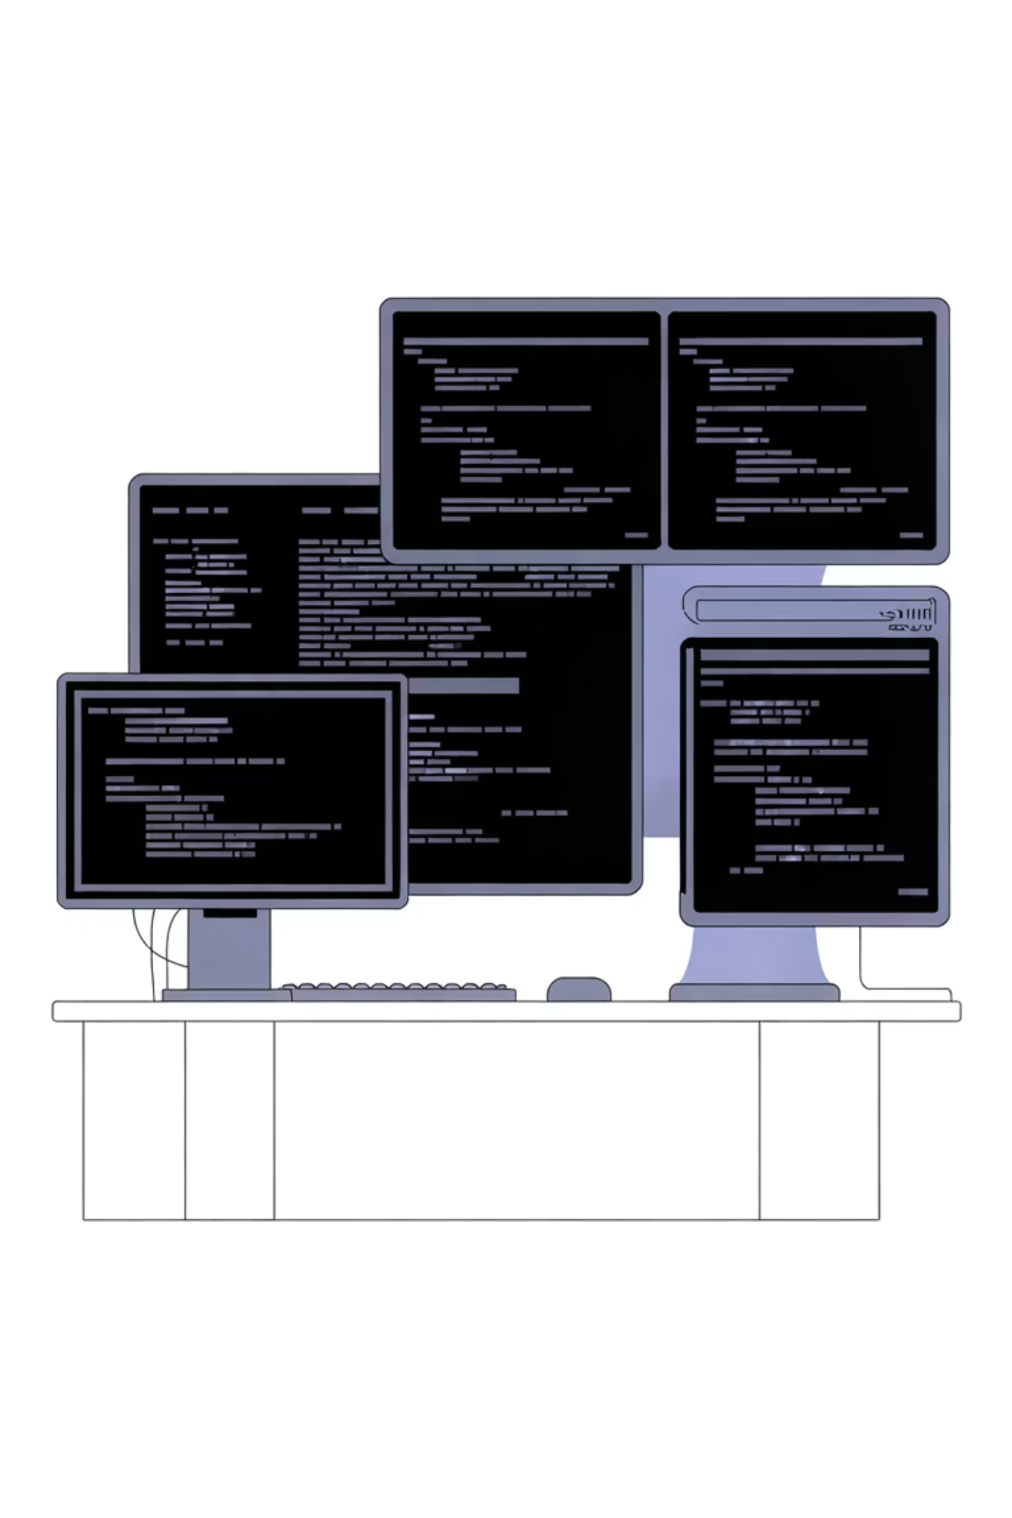

Automation Practice with Tools
Mastering Selenium, JIRA, and Bugzilla through hands-on experience

Slide 2
What We'll Cover Today
01
02
Tool Foundations
Practical Integration
Understanding Selenium WebDriver, JIRA workflows, and Bugzilla bug tracking essentials
Connecting automation frameworks with issue tracking systems for seamless workflows
03
04
Real-World Examples
Hands-On Practice
Live demonstrations and prototypes you can adapt for your projects
Interactive exercises to build confidence with each tool

Slide 3

Selenium WebDriver in Action
Core Capabilities
Selenium WebDriver enables browser automation across Chrome, Firefox, Safari, and Edge. It supports multiple programming languages including Java, Python, C#, and JavaScript.
Key automation patterns:
Element location using XPath, CSS selectors, and IDs
User interaction simulation (clicks, typing, scrolling)
Explicit and implicit wait strategies
Screenshot capture for test evidence
Example: A typical Selenium test script automates login validation across multiple browsers simultaneously.

Slide 4




JIRA & Bugzilla Integration Workflow
Defect Discovery
Auto-Logging
Track & Verify
Automated tests detect failures and capture detailed logs
Test frameworks create tickets in JIRA or Bugzilla with screenshots and stack traces
Teams triage, fix, and re-run automated tests to confirm resolution

Slide 5
Tool Comparison: Choosing Your Stack
Selenium
JIRA
Bugzilla
Best for: Cross-browser UI testing
Best for: Agile team collaboration
Best for: Traditional bug tracking
Open-source and free
Customizable workflows
Lightweight and fast
Large community support
Sprint planning tools
Advanced search capabilities
Language flexibility
Rich API for integrations
Email notifications
Grid for parallel execution
Comprehensive reporting
Proven stability
Tip: Start with Page Object Model design pattern
Tip: Use REST API to auto-create test execution tickets
Tip: Configure custom fields for automation metadata

Slide 6

Practical Example: End-to-End Flow
Scenario: E-commerce checkout testing with automated defect reporting
Test Execution
1
Selenium script validates shopping cart → payment → order confirmation across three browsers
2
Failure Detection
Payment page timeout detected in Firefox; Selenium captures screenshot and browser logs
Auto-Ticket Creation
3
Python script calls JIRA API to create bug ticket with priority, environment details, and attachments
4
Developer Investigation
Team reviews ticket, reproduces issue using provided data, and commits fix
Regression Testing
5
CI/CD pipeline triggers Selenium suite; all tests pass, ticket auto-transitions to "Verified"

Slide 7


Your Next Steps
Practice Daily
Build Integrations
Share Knowledge
Commit 30 minutes to writing Selenium scripts. Start with simple login flows, then add complexity.
Connect your test framework to JIRA or Bugzilla using REST APIs. Automate ticket creation from test failures.
Document your automation patterns and share with your team. Create reusable code libraries and templates.
Remember: The best automation engineers combine technical skills with practical problem-solving. Tools are powerful, but your strategic thinking makes them effective.

